Slide 1


JSPM’s Rajarshi Shahu College of Engineering Tathawade, Pune-411033 Department of Mechanical engineering Approved by AICTE (An Autonomous Institute Affiliated to Savitribai Phule Pune University) (NBA & NAAC Accredited) Peel Strength measuring machine guided by, Prof. N.A. Patil
Presented by – BE A Group No: 43
Dipraj Shinde (O2)
Deepak Shinde (07)
Shubham Awale (58)
Gauri Chatur (61)

Slide 2

What is peel strength ?
1. Peel strength is generally used to measure the bond strength of a material, typically an adhesive.
2. Peel strength is the average load per unit width of bond line required to separate bonded materials where the angle of separation is 180 degrees.

Slide 3

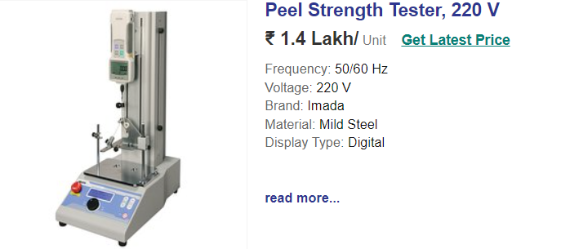
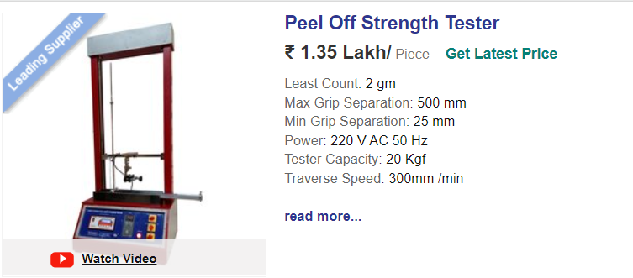
OBJECTIVE
For industry it's very important to measure peel strength of adhesive bonds and tapes.
Measuring machines which is currently available in market are Very expensive (nearly 1.2lac +). So main objective is to reduce this huge price.

Slide 4
Literature Review
Investigation Of Peel Resistance of Adhesive mater. By Yuvraj J. Awalekar, Atul S. Takalkar, Sachin S. Shinde.
In this paper we studied, Different adhesives are used for joining the different types of materials. The different types of peel tests available for investigating the adhesive strength are 90º, 135º, 180º and T-peel test.
2) ASTM D3330 Peel Adhesion Pressure Sensitive Adhesive Tapes. (https://www.testresources.net/applications/standards/astm/astm-d3330-peel-adhesion-pressure-sensitive-adhesive-tapes/)
In this article we studied, ASTM D3330 is one of the more popular testing standards to determine the adhesive strength of pressure sensitive tapes. This unique standard consists of Methods A through F, identifying ways to measure peel adhesion with 180 degree and 90 degree peel methods

Slide 5
3) Peel Adhesion of Coating Mat. (Mary E. McKnight, James F. Seiler, Tinh Nguyen, and Walter J. Rossiter.)
This article describes a quantitative, repeatable procedure for measuring peel adhesion that was developed at the National Institute of Standards and Technology (NIST) primarily to measure the adhesion of coatings to a steel substrate exposed to a wet environment. Two examples of its application are presented.

Slide 6
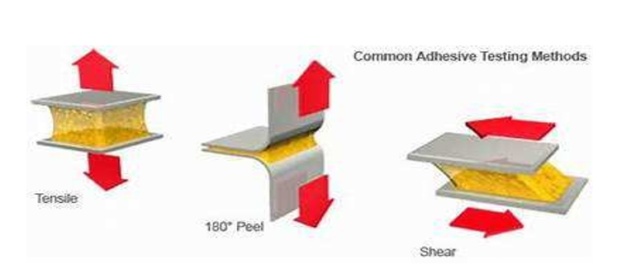
Types of Peel Tests by ASTM 1. T- Peel Test. 2. 90 degree test. 3. 180 degree test.

Slide 7

180 Degree peel for Method B of ASTM D3330
For Method B, measure out several strips of the tape according to the standard. Now apply a strip of the tape to a rigid panel, such as the standard stainless steel panel.
Use a Test Resources Sample Roller to firmly apply the tape to avoid bubbles. Apply a second strip of the tape to the backing of the first strip on the test panel, taking care to align the edges of the second specimen with those of the strip in the test panel.
Fold a tab of the tape and double back at an angle of 180 degrees. Next, clamp the substrate panel into the moveable jaw of testing machine and free end of tape into other jaw.

Slide 8
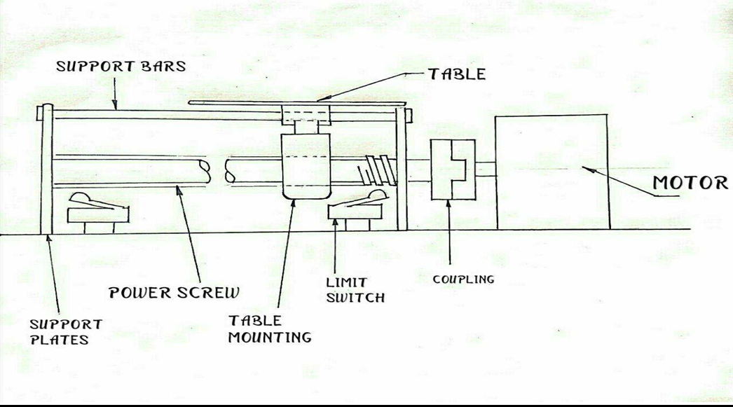
Experimental Setup

Slide 9
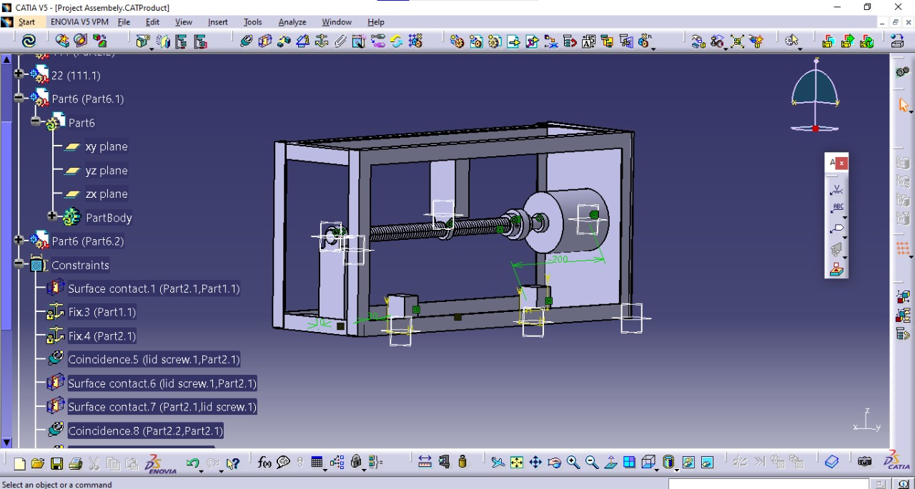
3-D Model of Setup

Slide 10
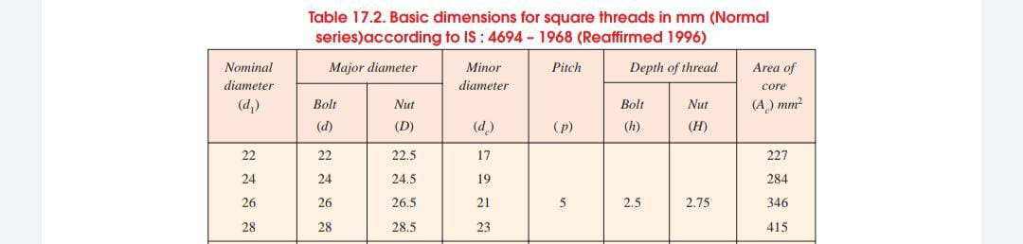

Theorotical Calculations Standard dimensions for Square threads
For our design, taking its compactness in size, working load of max. 20 kg and length of 40 cm in consideration we had chosen 24mm as Nominal dia. For square thread shaft. And as per IS:4694-1968 dimensions (all are in mm) are-
Nominal dIA = 24
Major dIA. = 24 (for bolt), 24.5 (for nut)
Minor Dia. = 19
Pitch = 5
Depth of thread = 2.5 (for bolt), 2.75 (for nut)
Coefficient of friction (for mild steel bolt and Nut) ($\tan{∅}$) = 0.09

Slide 11
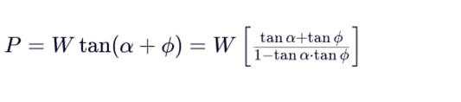

As per ASTM D3330 Standards peeling should be done with velocity of 300 mm/min, so
V = 300mm/min
So, this will be standard data, as we require low speed motor which carry max 20kg load, so we are estimating motor specifications as per follow-
W= 20kg = 20 x 9.81 N = 196.13 N
Motor Speed (N) = $\frac{velocity of nut }{Pitch of screw}$ = $\frac{300 }{5}$ = 60 rpm
Angular speed $(ω)$ = 2$π$ x $\frac{60}{60}$ = 6.28 rad/s
$\tan{α}$ =$\frac{Pitch }{π ×Dai. of screw }$ =$\frac{5}{3.14 x 24}$ = 0.06632
So, force required at circumference of the screw (P)
P= 30.8431 N

Slide 12

Torque of motor (T) = P x radius of power screw = 30.8431 x 12
= 370.112 N-mm
= 37.75 Kg-mm$≈3.78$kg-cm
Power of Motor (P) = $\left(ω\right)$ x (T) = (370.112 ×10^-3)x 6.28 = 2.324336 W
$≈2.5$ W

Slide 13

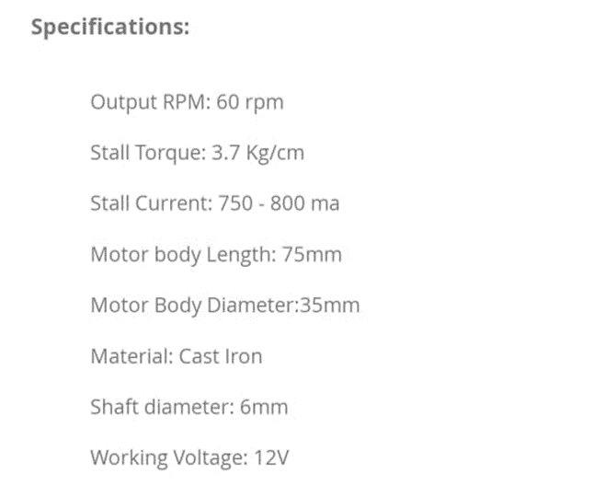
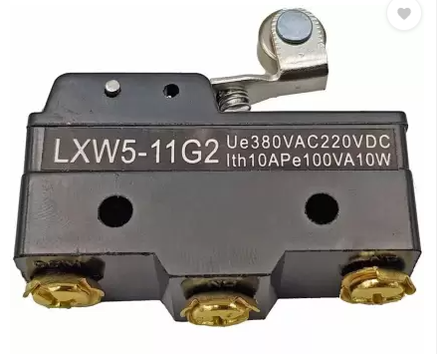
This parameter we had calculated for Electric Motor for our requirement, and from these specifications available electric motor in market is-
Roller lever micro limit switch (LXW-11G2) over limit switch Type - Programable Short Roller Hinge Lever Voltage - 220DC IP rating – 110VA

Slide 14

Progress Chart
Problem Identification and Finding solutions
Finding Best Mechanism
Design and Market Research
Fabrication and Assembly
Testing and Observations
In Progress…

Slide 15
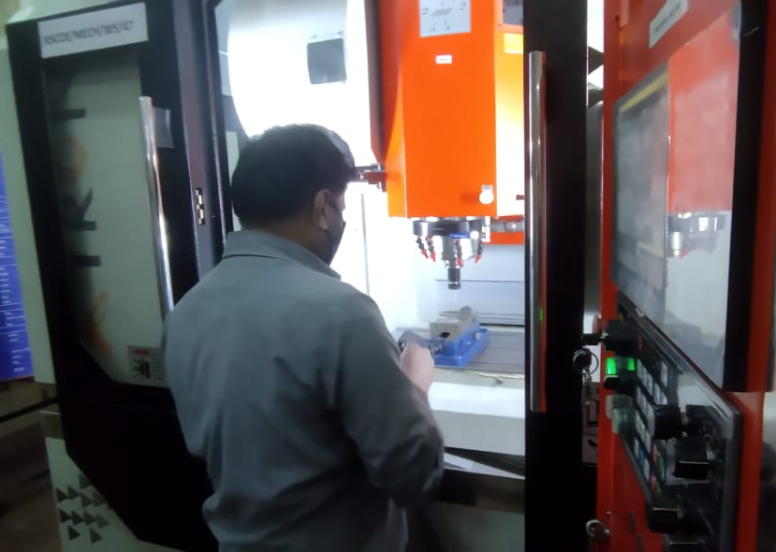
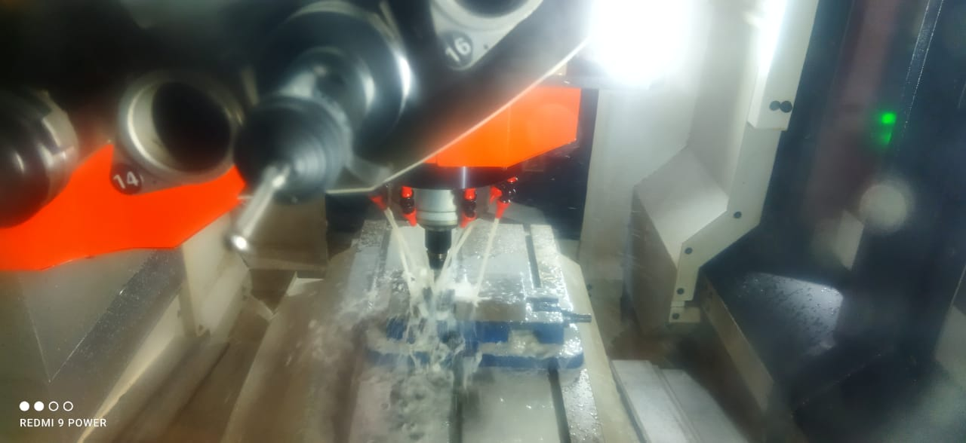
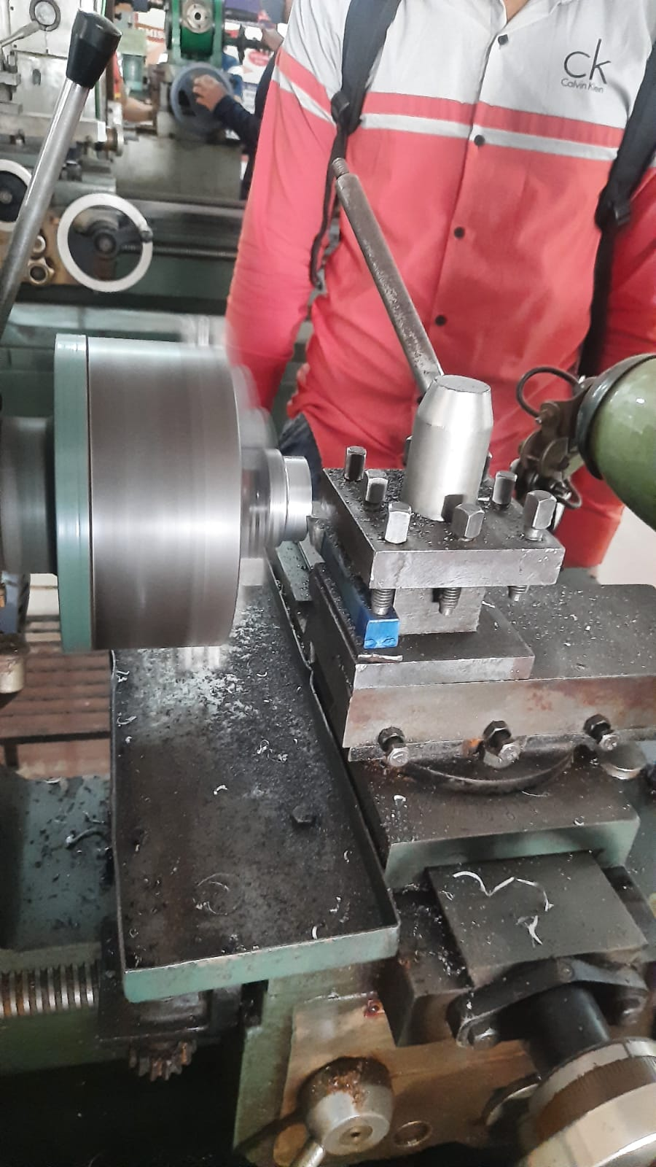
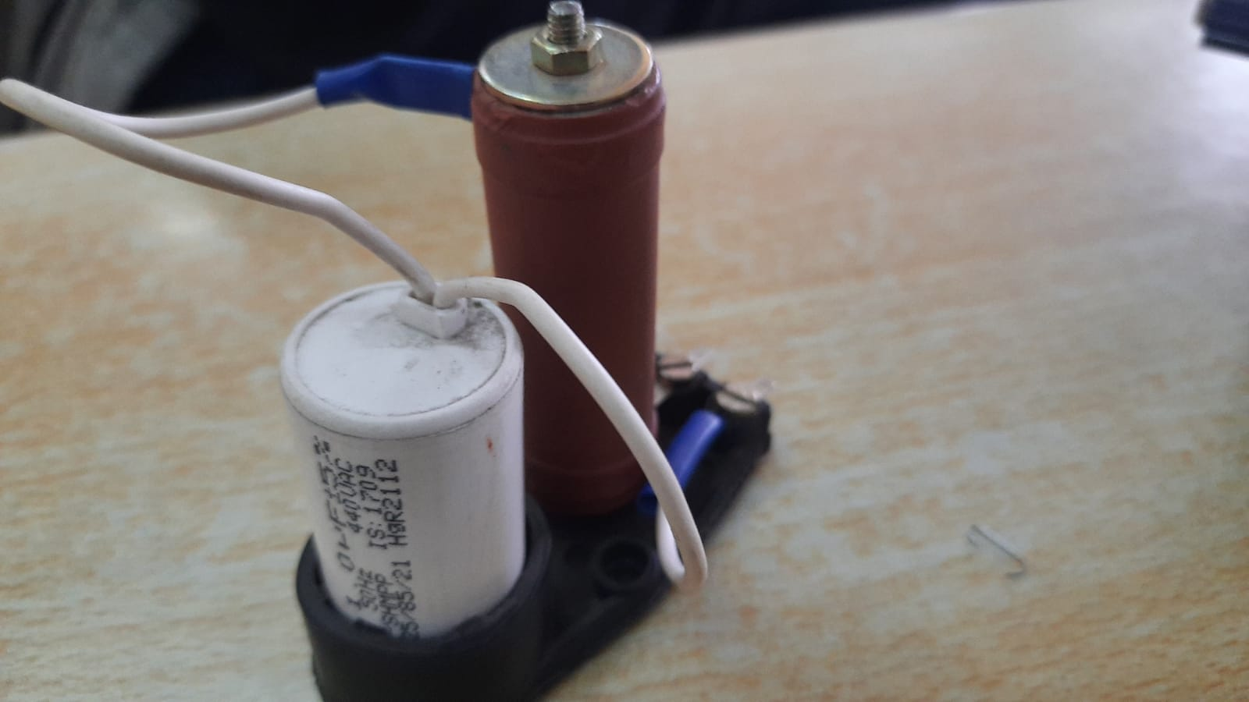
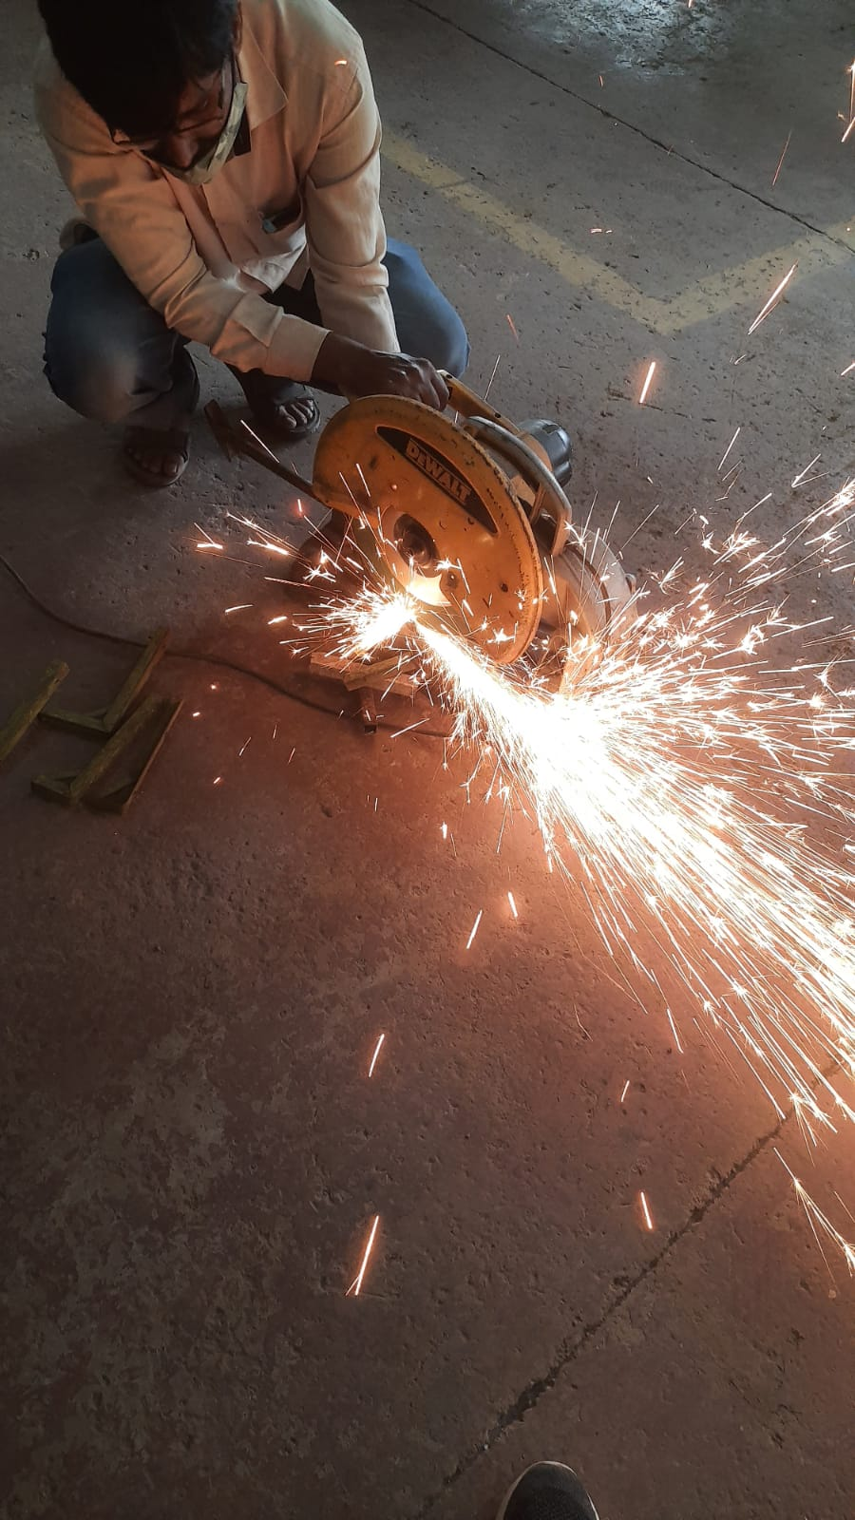
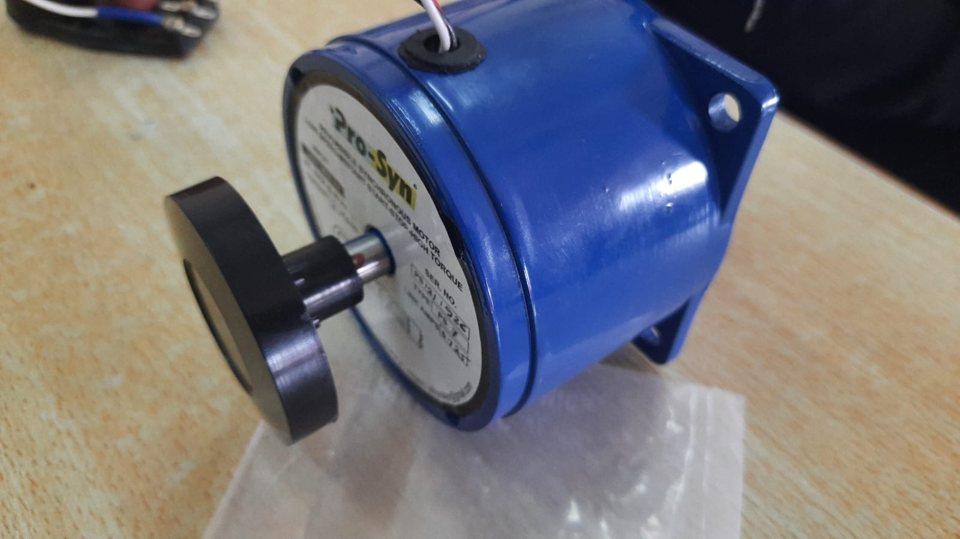
Glimses of manufacturing phase

Slide 16
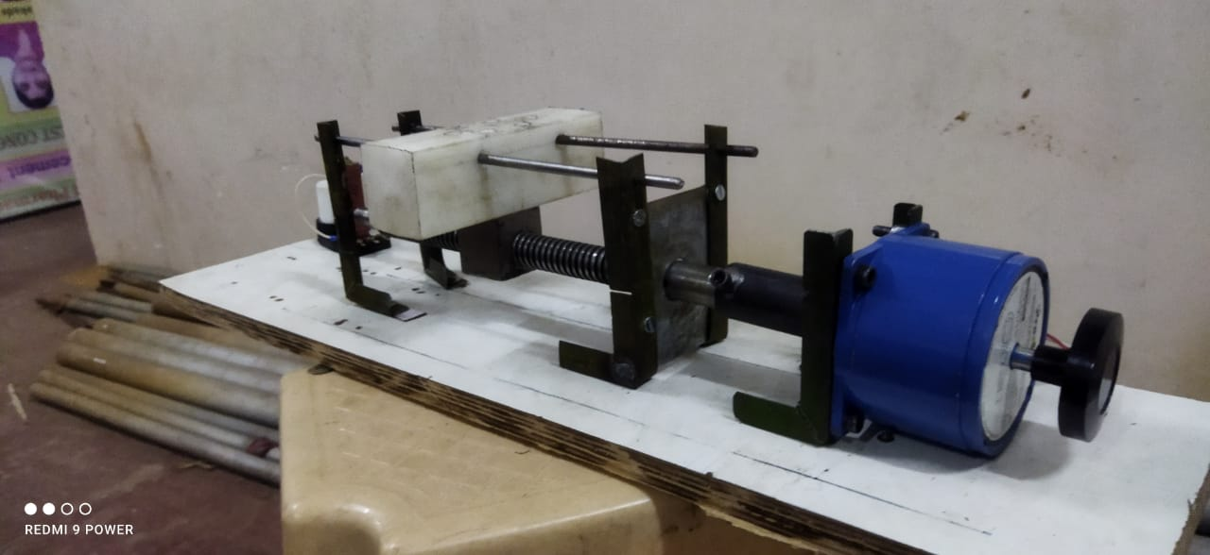
Assembled vieW
Table
Mount for super finish plate
L-clamps
Holding element
RC Circuit
To control RPM of motor
Motor
Prime mover
Plywood
Support for all elements
Lead Screw
To convert rotary motion to linear
Spokes
Guideways for table
Coupler
To couple motor shaft and lead scre

Slide 17
Remaining Work
Procurement of Gauge
Electrical Connections
Mounting of Super-finish plate
Installing limit-switches
Testing and Validation

Slide 18
Conclusion
Peel Strength Tester is widely used testing machine which is used in different packaging products manufacturing industries to test the bond or adhesive strength of self-adhesive products such as tapes, labels and many more
Peel Strength Test is one of the best testing machines which are used to measure the bonding strength of the packaging materials.
the benefit of performing objective, accurate and repeatable peeling testing can improve product consistency and assess interface adhesion.
It is expected to cost of other systems currently on the market is high. Bottom line is we help to just reduce the price of that machine

Slide 19
Future Scope
When a manufacturer think about peel testing, that costly about 1.5 lac machines came in mind, but this machine became so useful in that manner. If this machine is used it is possible to obtain accuracy at low cost about 10k. And if we use digital gauges, it will cost up to 45-50k (Depending on precision of digital gauge)
Hence In Future we can improve the accuracy of this, using digital measuring gauge. The single-coated tapes and assesses the peel adhesion at a 180 degree angle. (ASTM D3330 /3330D-04) evaluates the force required to the progressively separate two bonded, flexible adherents

Slide 20
Reference :
Text books. - adhesion science and Engineering, ( By Steaven Abott )
- The Complete Technology Book on Industrial Adhesive,
- The Fundamentals of Pressure Sensitivity, etc.
Internet Websites
http://www.intertek.com/polymers/testlopedia/peel-testing/
https://www.astm.org/Standards/D3330.htm
https://www.testresources.net/applications/standards/astm/a stm-d3330-peel-adhesion-pressure-sensitiveadhesive-tapes/
Research Papers.
Proceedings of Engineering and Technology Innovation, vol. 10, 2018, pp. 19 - 28 Investigation of
Resistance of Adhesives Materials: A Review By Yuvraj J. Awalekar, Atul S. Takalkar, Sachin S. Shinde.

Slide 21
Thank You !

